Slide 1
THE GREAT DEPRESSION
1929-1941

Slide 2
Prelude
In 1928, the U.S. Economy looked healthy.
Uneven Prosperity.
  Rich get richer, poor get poorer.
Personal Debt.
  Overused Credit.
  Unable to pay back loans.
Playing the Market.
  High risk investments

Slide 3
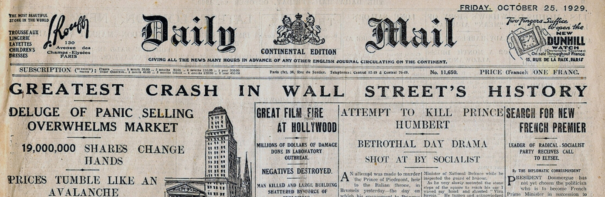
Prelude (cont.)
High Supply, Low Demand.
  Overproduction.
Income Decreases.
  Long hours, low wages.

Slide 4
Depression Begins
DOW (Dow Jones Industrial Average)
  Climbs before starting a slow drop.
  Sharp decline follows.
    Also known as the Great Crash.
    Occurs on October 19th, 1929 (called Black Tuesday.)
Banks.
  People unable to pay back debts in such a short amount of time.
  Banks lent out more than they had.
  They also used money from savings accounts for previous loans.

Slide 5
The Banks
https://www.youtube.com/watch?v=iPkJH6BT7dM

Slide 6
Unemployment
Rise in Unemployment Numbers.
  1929 – 1 Million unemployed.
  1930 – Over 4 Million unemployed.
  1933 – Over 13 Million Unemployed.
    25% of the U.S. Population.
Unemployment.
  Less money to spend.
  Less money businesses receive.
  Less money to pay wages.
  Rinse and repeat.

Slide 7
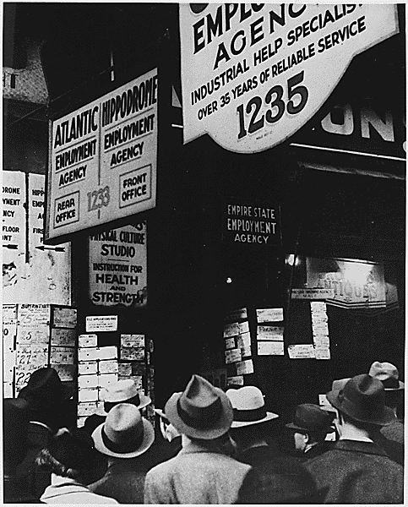
Unemployment (cont.)
https://www.youtube.com/watch?v=5IMbKdSAW7Y

Slide 8
International
The crash of the U.S. economy affected the world market.
  Depressions in other countries followed.
    Ex: Europe, Latin America, and especially Germany.
    Germany is unable to pay debts and reparations from WWI because it relied heavily on U.S. companies for income.

Slide 9
President Hoover’s Response
President Hoover wins the election in 1928.
  Initially popular with the people.
  Later blamed for not taking enough action during the crisis.
  Left the office in 1932 with one of the lowest approval ratings before Franklin Roosevelt (FRD) takes office.
    He did too little, too late.
Hoover’s actions.
  Refused to give government aid, which he called “handouts.”
  Asked business owners to retain workers.
    Failed, as it only lowered wages.
  Told citizens to have “rugged individualism.”
    Hard work gives rewards.

Slide 10
Life During the Great Depression
Loss of income meant that people could not afford many things for their home.
  Gas for vehicles, clothing, food, etc.
  Resulted from unemployment, lowered wages, and part time work.
  Homelessness and starvation became much more common.
    Shanties were makeshift homes created from shacks and tents, built by homeless families.
New practices came within households.
  Rationing food and water.
  Growing gardens for additional food.
  Repairing old clothing instead of buying new.

Slide 11
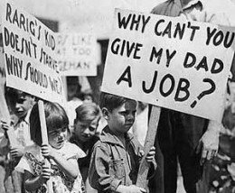
Life During the Great Depression
More women entered the workforce to sustain their families.
Fewer people married and less children were born during this time.
More quarrels in homes because of unemployed men.
https://www.youtube.com/watch?v=lNXTKVxOmfk

Slide 12
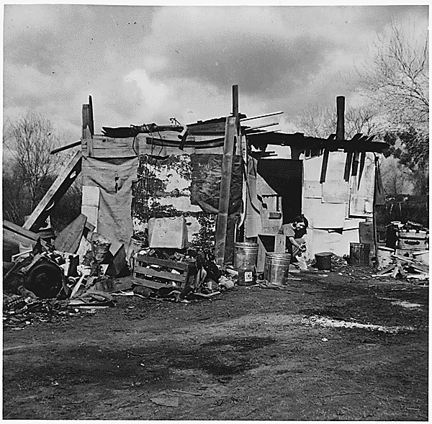
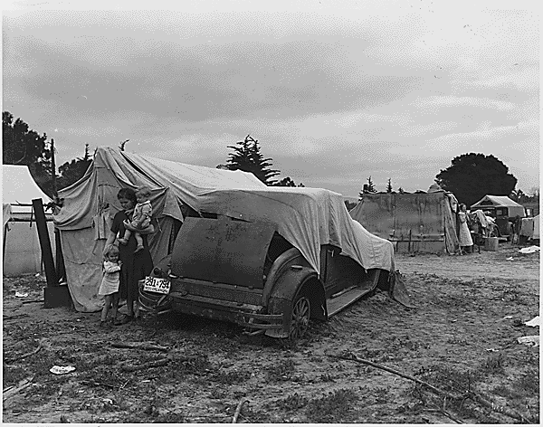
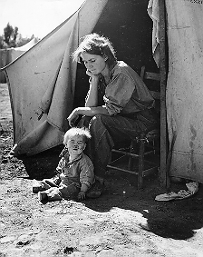
Shanties

Slide 13
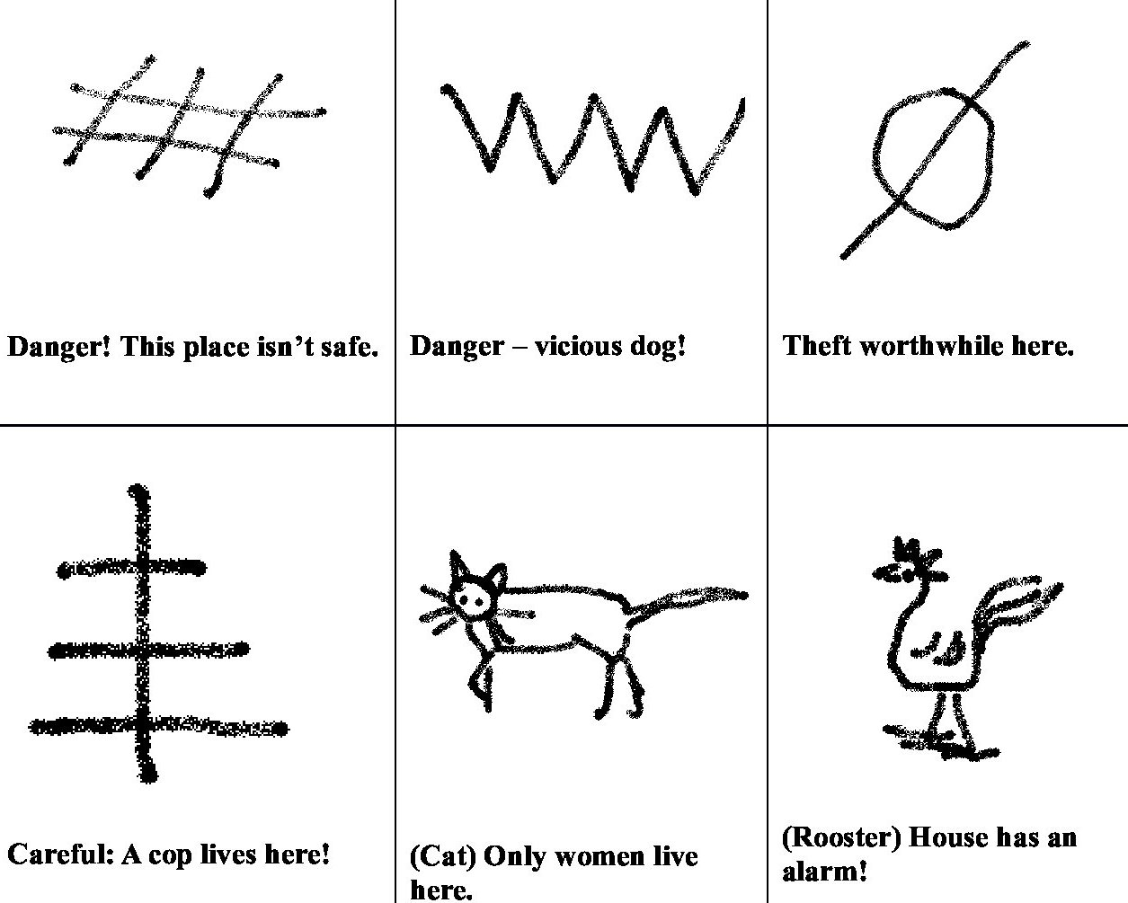
Homeless Symbols

Slide 14
Work Conditions
Job security was poor.
  Many workers laid off to hire cheaper labor.
  Some jobs only hired temp workers to rotate who get’s paid each day.
  Temp workers would take whatever job they can get and were usually not members of a union.
More work for less money.
  While wages were lowered, the hours of some jobs increased, such as factory work.
Child workers were forced into the same working conditions as adults.

Slide 15
Outlook
Many people who endured the Great Depression gained a new outlook on life.
  Not to take what they have for granted.
  Better management skills with good/possessions.
  Less self-indulgence.
  Gratitude for aid and gracious giving.
  More focus on family and relationships.
  Religious appreciation.
  https://www.youtube.com/watch?v=jNWHm5L0NlI

Slide 16
QUIZ

Slide 17
BONUS
https://www.youtube.com/watch?v=2q2scjQipwM

